Slide 1

Keep it Local, Go Global: Conquering Data Persistence in Flutter

Slide 2


Introduction to Data Persistence in Flutter
Data Persistence Defined
Data Loss Catastrophe
Storage Solutions at Your Fingertips
Notes:
Data Persistence Defined: Remember that crucial information users input or generate within your app? Persistence keeps it safe and accessible, even after they close the app or restart their device.
Data Loss Catastrophe: Imagine the frustration of lost progress, forgotten notes, or vanished preferences. Data loss erodes user trust and can cripple app functionality.
Storage Solutions at Your Fingertips: Embrace the power of local storage (on-device), cloud storage (remote access), or hybrid approaches to ensure your app's data endures, adapts, and thrives.

Slide 3
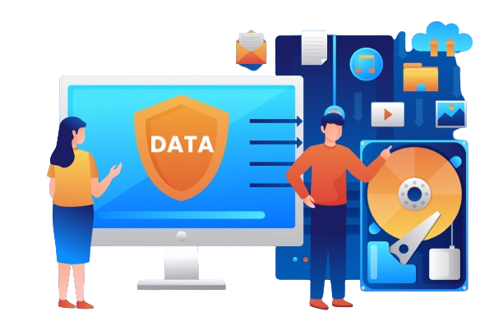
SQLite - Your Powerful On-Device Data Guardian
SQLite is a powerful and lightweight SQL database engine embedded directly into your Flutter app.
Key advantages:
Efficient Performance: Queries and data manipulation are lightning-fast, ensuring a smooth user experience.
Offline Accessibility: Data persists on the device, offering full functionality even when disconnected.
Complex Data Handling: Store and manage structured data with ease, from simple key-value pairs to intricate relationships.
Notes:
SQLite is a powerful and lightweight SQL database engine embedded directly into your Flutter app.
key advantages:
Efficient Performance: Queries and data manipulation are lightning-fast, ensuring a smooth user experience.
Offline Accessibility: Data persists on the device, offering full functionality even when disconnected.
Complex Data Handling: Store and manage structured data with ease, from simple key-value pairs to intricate relationships.

Slide 4
SqLite
SQLite is a lightweight, serverless, and embedded relational database management system. It stores data in a single file on the device, making it suitable for mobile applications.
Integration: Flutter uses the sqflite plugin to interact with SQLite databases. This plugin provides functionalities for creating, opening, querying, updating, and deleting data within the SQLite database.
Key Points:
Lightweight: SQLite is small and efficient, ideal for mobile apps with limited storage and processing power.
Serverless: It doesn't require a separate server process, simplifying app development and deployment.
Relational: Data is organized in tables with relationships, enabling structured data management.
Local Storage: Data resides on the device, providing offline access and faster read/write operations compared to remote databases.

Slide 5

Bringing SQLite Onboard: A Step-by-Step Guide
Setting up SQLite: Provide a step-by-step guide on integrating SQLite into your Flutter project, including dependencies and initialization.
Notes:
1. Add dependencies:
Open your pubspec.yaml file.
Add the following dependencies:
sqflite: This is the main package for interacting with SQLite in Flutter.
path: This package helps manage file paths for the database.
2. Database model:
Define your data model using Dart classes. Each class property represents a column in the database table.
3. Database helper:
Create a separate class to handle database operations like opening, creating tables, and CRUD (Create, Read, Update, Delete) functions.
4. Initialize the database:
In your main widget or a dedicated service, call the DatabaseHelper.database getter to open the database connection.
5. CRUD operations:
Implement methods in your DatabaseHelper class to perform CRUD operations using the sqflite package's functions like insert, query, update, and delete.

Slide 6
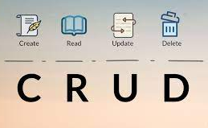
CRUD in Action: Data Magic with SQLite
Demonstrate the core CRUD operations using clear and concise code snippets:
Create: Add new data entries to your table.
Read: Fetch existing data based on specific criteria.
Update: Modify existing data entries with new values.
Delete: Remove unwanted data entries from your table.
Notes:
Demonstrate the core CRUD operations using clear and concise code snippets:
Create: Add new data entries to your table.
Read: Fetch existing data based on specific criteria.
Update: Modify existing data entries with new values.
Delete: Remove unwanted data entries from your table.

Slide 7
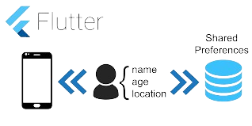
Shared Preferences - Your Lite Data Companion
Shared Preferences is a convenient and efficient way to store small amounts of data like user settings, app preferences, or basic session information.
key strengths:
Lightweight: Minimal impact on app size and performance.
Simple: Easy to use with built-in functions for storing and retrieving key-value pairs.
Fast: Quick access to data for a smooth user experience.
Shared Preferences shines for storing straightforward data, keeping your app lean and optimized.
Notes:
Shared Preferences is a convenient and efficient way to store small amounts of data like user settings, app preferences, or basic session information.
key strengths:
Lightweight: Minimal impact on app size and performance.
Simple: Easy to use with built-in functions for storing and retrieving key-value pairs.
Fast: Quick access to data for a smooth user experience.
Shared Preferences shines for storing straightforward data, keeping your app lean and optimized.

Slide 8
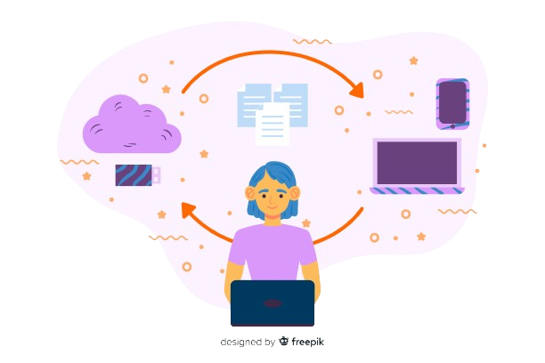
Putting Shared Preferences to Work: Store, Retrieve, Optimize
Storing data: Use functions like setString, setInt, setDouble, etc.
Retrieving data: Use corresponding functions like getString, getInt, getDouble, etc.
Highlight supported data types (String, int, double, bool).
Notes:
Storing data: Use functions like setString, setInt, setDouble, etc.
Retrieving data: Use corresponding functions like getString, getInt, getDouble, etc.
Highlight supported data types (String, int, double, bool).
key tips for efficient and secure data management:
Avoid storing complex data structures or large amounts of information.
Use batch updates for improved performance with multiple key-value pairs.
Leverage secure data types like encrypted strings for sensitive information.

Slide 9

Key tips for efficient and secure data management:
Avoid storing complex data structures or large amounts of information.
Use batch updates for improved performance with multiple key-value pairs.
Leverage secure data types like encrypted strings for sensitive information.

Slide 10
Beyond the Session: Understanding State Persistence and Restoration
Beyond Session: We've managed app state while it's open, but what about after closing the app?
Introducing Persistence: This saves data across app sessions, even after restarts.
Why it Matters:
Pre-populated forms save time and effort.
Saved game progress keeps users engaged.
Personalized experiences based on preferences.
Imagine: A "remember me" login, a seamless return to unfinished tasks, or a feed curated to your interests.
Persistence: Creates a welcoming and familiar app experience, every time.
Notes:
Beyond Session: We've managed app state while it's open, but what about after closing the app?
Introducing Persistence: This saves data across app sessions, even after restarts.
Why it Matters:
Pre-populated forms save time and effort.
Saved game progress keeps users engaged.
Personalized experiences based on preferences.
Imagine: A "remember me" login, a seamless return to unfinished tasks, or a feed curated to your interests.
Persistence: Creates a welcoming and familiar app experience, every time.

Slide 11

Guarding the Walls: Securing Your App's Data Treasures
AES to the Rescue:
Strong Foundations:
Key Security:
No Room for Plain Text:
Notes:
AES to the Rescue: Imagine scrambling your data into a secret code only you can break. That's what the Advanced Encryption Standard (AES) does, transforming readable information into an unreadable mess for anyone without the key.
Strong Foundations: Use only proven and robust encryption algorithms like AES for maximum security. Weaker methods are like flimsy locks easily picked by attackers.
Key Security: The key to decrypting your data is like the master key to your vault. Keep it safe! Store keys securely on the device using secure enclaves or in a remote server with strong access controls.
No Room for Plain Text: Sensitive information like passwords or financial details deserve extra protection. Avoid storing them unencrypted – treat them like whispered secrets, never written down in plain sight.

Slide 12

Beyond the Binary Walls: Advanced Data Modeling for Complex Needs
Beyond Basic Pairs: While key-value pairs work well for simple settings, complex app data with intricate relationships needs sophisticated solutions.
Exploring Options: Introduce alternative data models for your Flutter app:
JSON: Lightweight and flexible format for storing nested data structures and arrays, offering structure beyond flat key-value pairs.
No SQL Databases: Embrace schema-less databases like Firestore or Realm for scalable and flexible data storage, adapting to your evolving data needs.
Key-Value: Simple, efficient, but limited to flat structures.
Notes:
Beyond Basic Pairs: While key-value pairs work well for simple settings, complex app data with intricate relationships needs sophisticated solutions.
Exploring Options: Introduce alternative data models for your Flutter app:
JSON: Lightweight and flexible format for storing nested data structures and arrays, offering structure beyond flat key-value pairs.
NoSQL Databases: Embrace schema-less databases like Firestore or Realm for scalable and flexible data storage, adapting to your evolving data needs.
Key-Value: Simple, efficient, but limited to flat structures.

Slide 13

Taking Data to the Cloud - Embrace Scalability and Convenience
Data's Global Journey: Your app's data can now soar beyond the confines of a single device, accessible from anywhere on any connected screen. Imagine instant updates across phones, tablets, and desktops, keeping everyone in sync seamlessly.
Peace of Mind in the Cloud: Never fret about lost data again! Automatic backups ensure your precious information is always safe and sound, tucked away in the secure clouds above, ready to be restored at a moment's notice.
Grow Without Limits: As your app takes flight, so too can its storage. Cloud solutions effortlessly expand alongside your needs, providing endless space for your data to roam without ever feeling cramped.
Notes:
Data's Global Journey: Your app's data can now soar beyond the confines of a single device, accessible from anywhere on any connected screen. Imagine instant updates across phones, tablets, and desktops, keeping everyone in sync seamlessly.
Peace of Mind in the Cloud: Never fret about lost data again! Automatic backups ensure your precious information is always safe and sound, tucked away in the secure clouds above, ready to be restored at a moment's notice.
Grow Without Limits: As your app takes flight, so too can its storage. Cloud solutions effortlessly expand alongside your needs, providing endless space for your data to roam without ever feeling cramped.

